Slide 1
Peninsula Anatomy Lectures
Session 1 – The abdominal wall & hernias
John Pascoe
F2 Derriford Hospital

Slide 2
What this course adds
Anatomy for exams and for pushy surgical blocks
Clinical situations
Practice AMK questions
We need your feedback

Slide 3
Todays Learning Objectives
Layers of the abdominal wall
Surgical Incisions/spotting the surgical scar
Define hernias
Complications of hernias
Clinical anatomy of inguinal & femoral hernias
+ lots of pictures & AMK questions

Slide 4
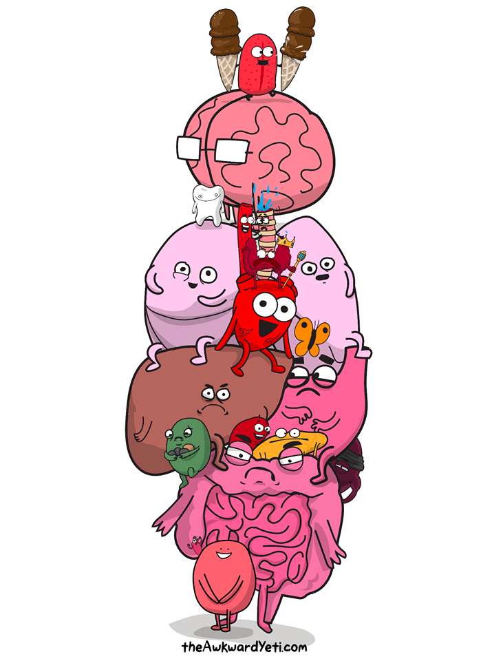
Dull facts
Learning anatomy is not easy
Repetition is key
Mnemonics help
Use in clinical situations

Slide 5
“Basic Basics”
Mid clavicular line
Subcostal line
Inter-tubercular line

Slide 6
“Basic Basics”

Slide 7
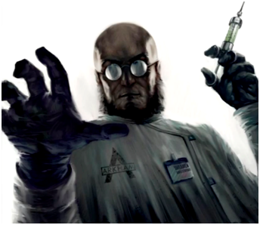
Layers of the abdominal wall
“When I make my incision, what am I dissecting through”
-Every surgeon ever wishing to torture a Peninsula Medical student -

Slide 8
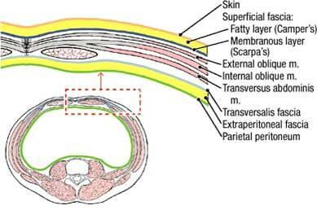
Layers of the abdominal wall

Slide 9
Layers of the abdominal wall
Skin
Subcut fat
Superficial fascia (Camper’s)
Deep fasica (Scarpa’s)
Muscles*
Transversalis fasica
Extraperitoneal fat
Peritoneum
Some
Students
Swig
Drinks
Many
Try
Enjoying
Port
¹Mnemoinic Pascoe J. 2015

Slide 10
What were those layers???

Slide 11
Muscles of the abdominal wall
Depends on the incision:
External oblique
Internal oblique
Rectus abdominis
Transverse abdominis
Pyramidalis
Rectus sheath
Notes:
External – hand in pocket forms anterior rec sheath
Internal @ R angles to external forms ant & post rec sheath
Transverse – runs transversely forms post rec sheath
Rectus abdominis held in rec sheath. Attached anteriorly by three bilateral tendons. Good blood supply from Superior & inferior epigastric vessels.

Slide 12
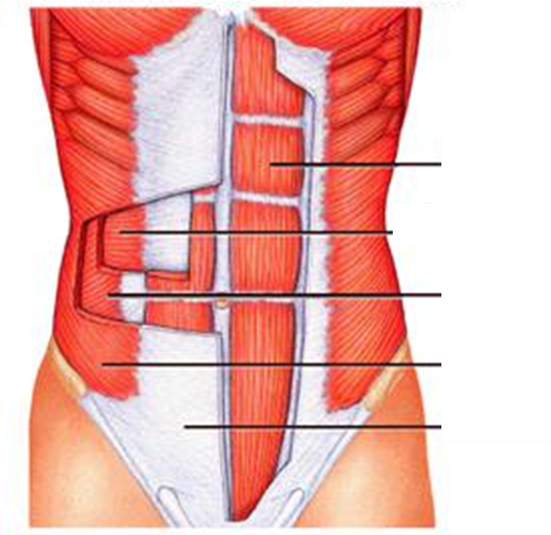
Abdominal Muscles
Rectus Abdominis
Transverse Abdominis
Internal Oblique
External Oblique
Aponeurosis

Slide 13
Qualities of a good incision
Easy access
Rapid access
Favours the possibility of extension
Favours secure wound healing and opposes herniation
Cosmetic
Pain-free

Slide 14
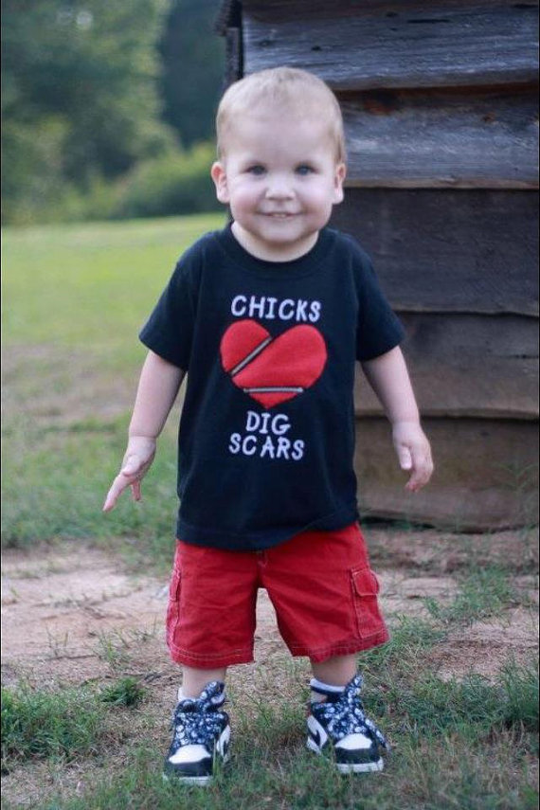
Spot that scar
Useful in ISCE’s/OSCE’s & real life
Remember more laparoscopic surgery now

Slide 15
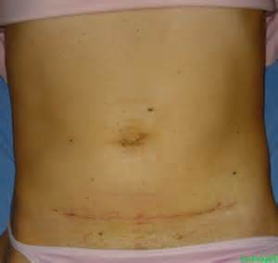
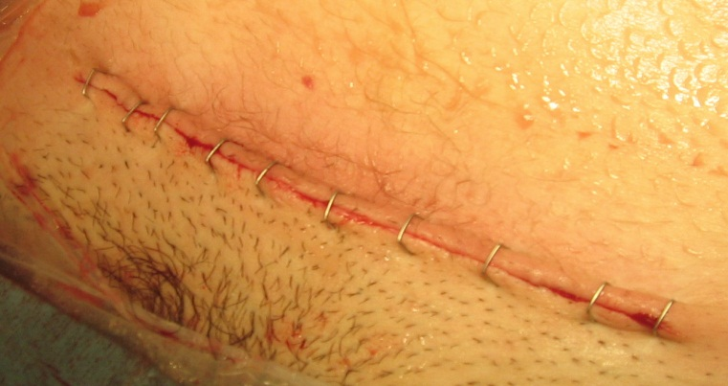
Spot that scar (I)
Pffannenstiel incision
How:
Horizontal curved incision above Pubic symphysis
Indication:
Caesarean
Cystectomy
Advantages:
Easy to do
Cosmetic
Disadvantages:
Limited views for oncology surgery

Slide 16
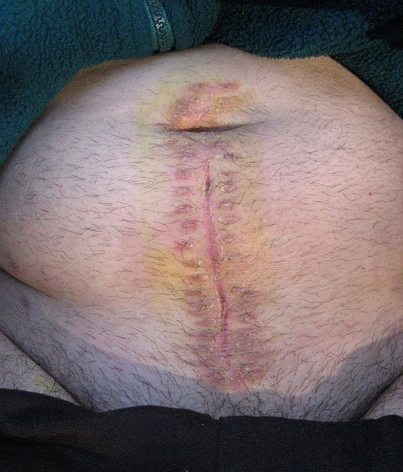
Spot that scar (II)
Midline incision
How:
Dissect through the linea alba & pyramidalis
Indication:
Multiple abdominal surgeries
Advantages:
Good access
Can be extended for further access
Disadvantages:
Poor cosmetic appearance as crosses langers lines

Slide 17
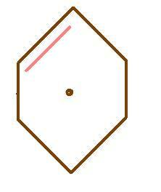
Spot that scar (III)
Kochers incision
How:
3cm below and parallel to costal margin from midline to rectus border
Indication:
R Sided – open cholecystectomy
L sided – splenectomy
Advantages:
Good access/views
Disadvantages:
May cause damage to superior epigastric vessels & intercostal nerves if extended to far laterally

Slide 18
Spot that scar (IV)
Rooftop incision
How:
Double Kocher’s
Indication:
Liver/spleen/pancreatic/ adrenal surgery
Advantages:
As Kochers
Disadvantages:
As Kochers

Slide 19
Ten Minute break

Slide 20
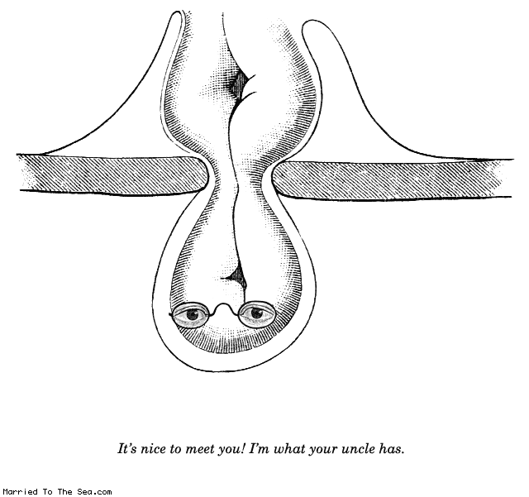
Hernias
Q1) What is a hernia???
Q2) How many different kinds of hernias can you name??

Slide 21
Complications of hernias aka why do we care??
Hernias can be bad……like real bad….REAL FUCKING BAD!
Sometimes they get so bad you have to give them a name as they gain Gillick competence they are so big and bad!
My hernia is called Rickardo, what would you call yours?
Ps please be aware that not all hernias are as friendly as Rickardo…some ae proper dick heads and may get strangulated etc……we call them wankers

Slide 22
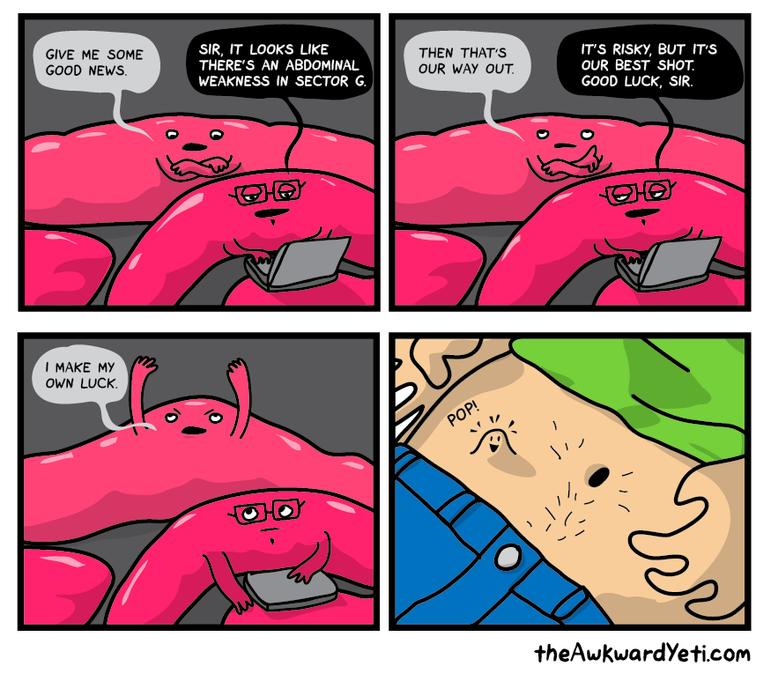
Hernia Definition
“A Protrusion of all or part of a viscus through the wall of a cavity in which it is normally contained”

Slide 23
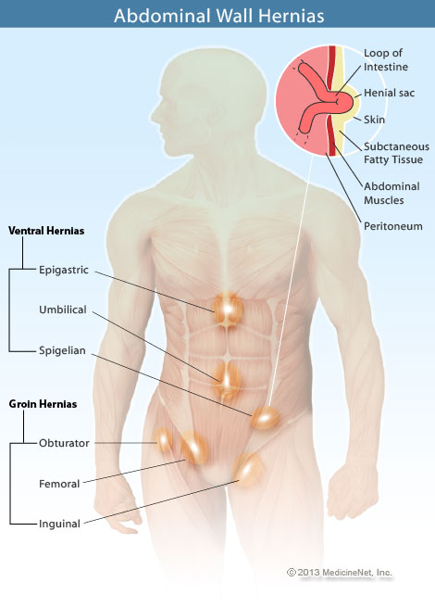
Types of abdominal hernias
Inguinal
Femoral
Umbilical
Para-umbilical
Incisional
Obturator
Spigalean
Epigastric
Lumbar
When approaching hernias it is useful to think of patient:
Gender
Age

Slide 24
Complications of hernias aka why do we care??
Hernias can be bad……like real bad….REAL FUCKING BAD!
Sometimes they get so bad you have to give them a name as they gain Gillick competence they are so big and bad!
My hernia is called Rickardo, what would you call yours?
Ps please be aware that not all hernias are as friendly as Rickardo…some ae proper dick heads and may get strangulated etc……we call them wankers

Slide 25
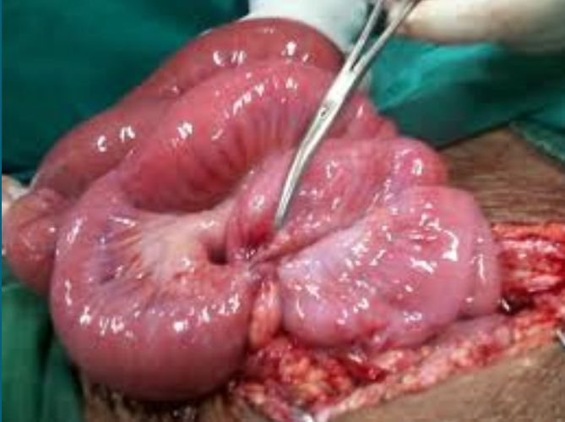
Complications of hernias aka why do we care??
Incarceration
Mechanical Obstruction (4 cardinal signs)
Strangulation

Slide 26
Inguinal Canal
6 cm inter-muscular path
Above inguinal ligament
Connecting the deep and superficial rings.
Transmits
Spermatic cord
Round ligament

Slide 27
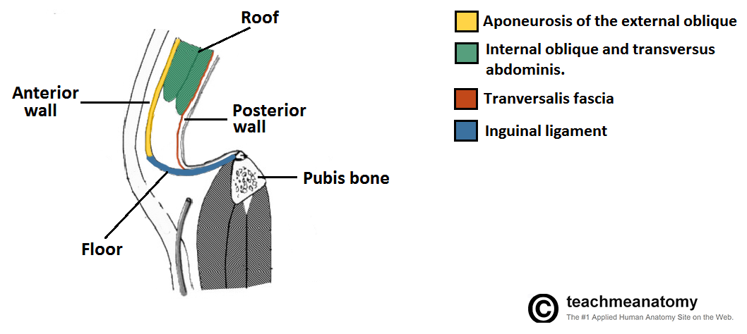
Borders of inguinal canal
Roof
Transverse oblique, Internal oblique, conjoint tendon
Anteriorly
External oblique
Floor
Inguinal ligament & Lacunar ligament
Posteriorly
Transversalis fascia & conjoint tendon

Slide 28
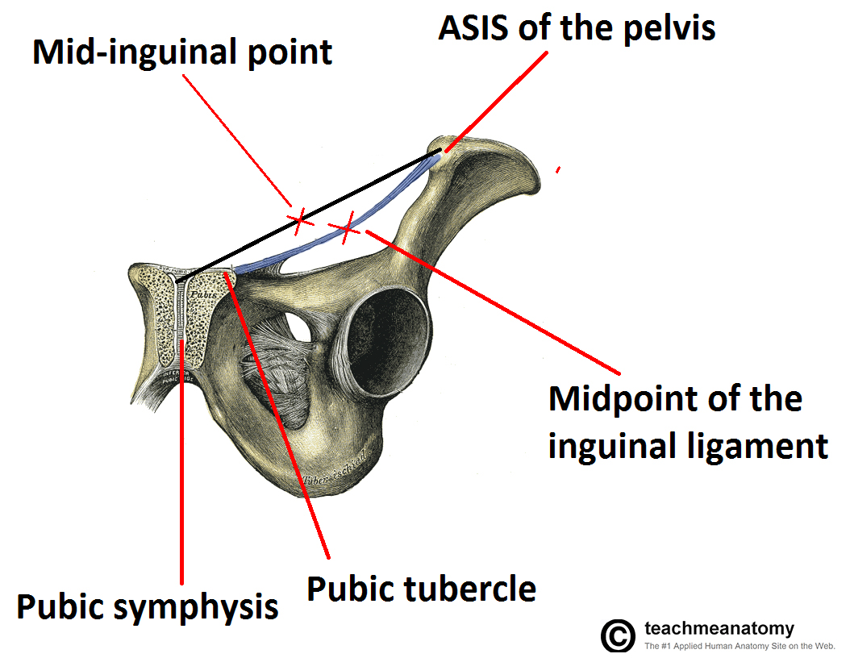
Inguinal ligament markings
Mid-Inguinal point
Femoral Artery
ASIS to Pubic symphasis
Midpoint of the inguinal ligament (longer/more things)
Femoral Nerve & deep inguinal ring
ASIS to Pubic tubercle

Slide 29
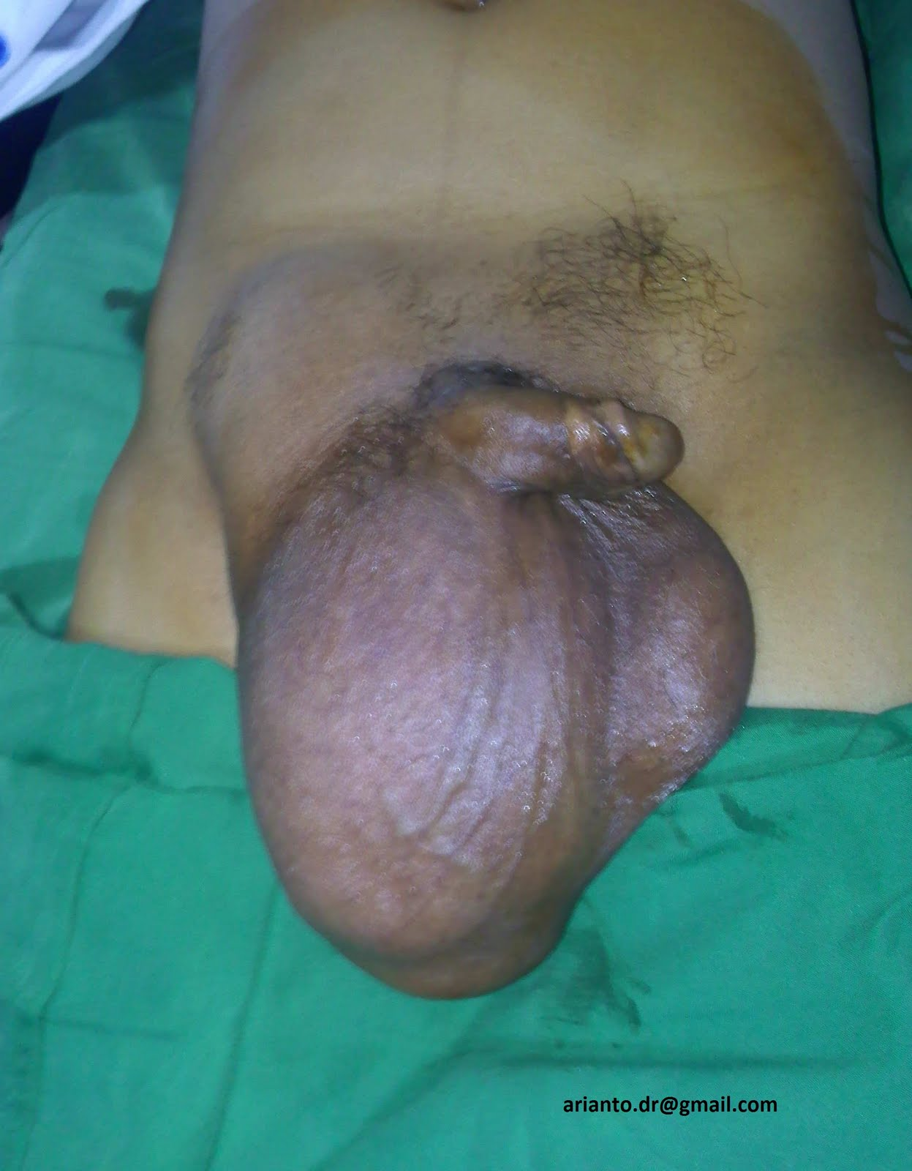
Inguinal Hernias
Indirect
Peritoneal contents enter the inguinal canal via the deep inguinal ring
More likely than direct to descend into the scrotum/labia majora
Caused by failure of the processes vaginalis
Accounts for 60% of inguinal hernias
4% of male infants will have

Slide 30
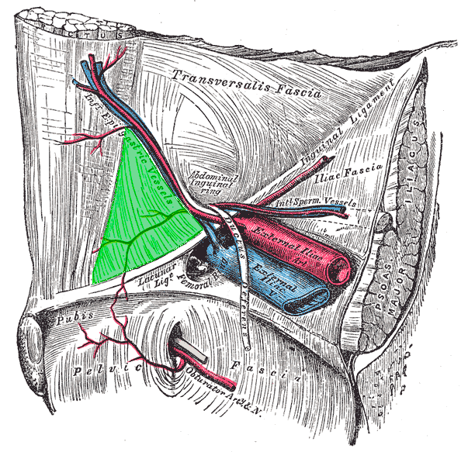
Inguinal hernias
Direct
Herniate directly through a weakness in the posterior wall of the inguinal canal
Acquired
Usually through Hesselbach’s triangle
RIP

Slide 31
Quick Recap
Define hernias
Inguinal canal anatomy
Inguinal hernias: Indirect & direct
Nearly done…Only femoral anatomy, femoral hernias & AMK Q’s left

Slide 32
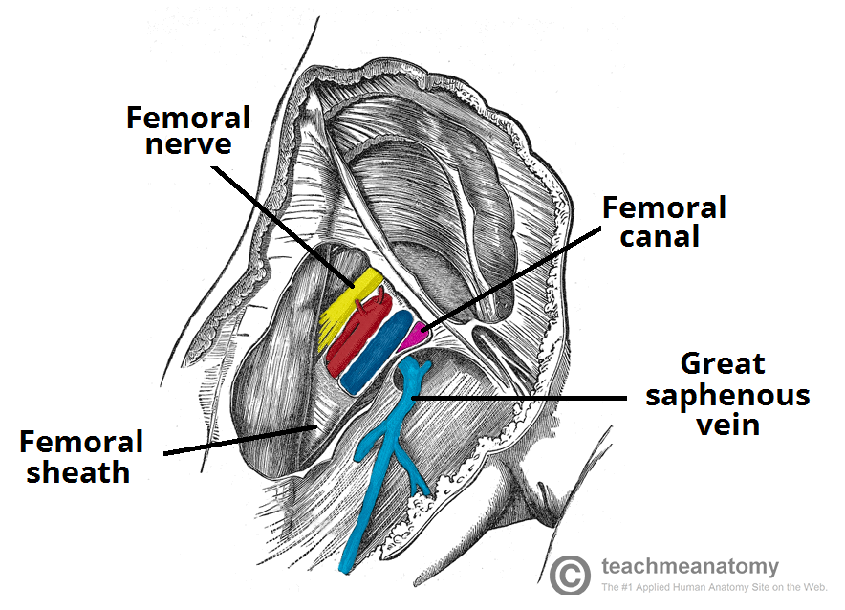
Femoral anatomy
Femoral triangle
Femoral Sheath
Femoral Canal
Femoral ring
NAVY

Slide 33
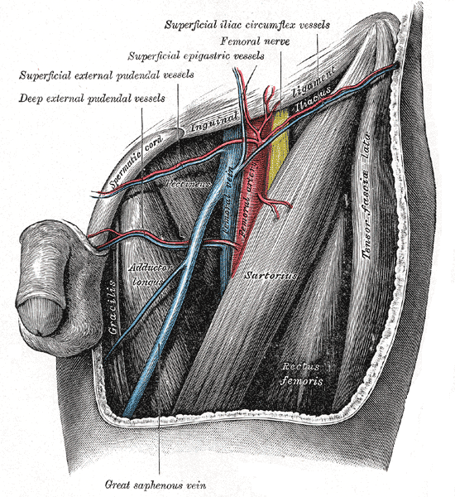
Femoral Triangle
SAPpy bit of anatomy
Sartorius
Adductor longus
Inguinal ligament/Pouparts ligmanet

Slide 34
Femoral Sheath
Anteriorly – continuation of the transversalis fascia
Posteriorly – continuation of the fascia iliacus/psoas fascia
Contents (GAVL)
Genitofemoral nerve (femoral branch)
Femoral Artery
Femoral Vein
Lymphatics

Slide 35
Femoral canal
Medial dead space in the femoral sheath
Contains lymphatics
Efferent lymph vessels from deep inguinal nodes
Deep inguinal nodes of cloquet
The route of femoral hernias
Opening is called the femoral ring

Slide 36
Femoral ring (hernias FISL through)
Anteriorly
Inguinal/Poupart’s ligament
Posteriorly
Superior Pubi ramus covered by pectineus muscle
Medially
Lacunaur ligament
Laterally
Femoral Vein

Slide 37
Groin hernias: Indications for surgical repair
ELECTIVE | - Indirect - Symptomatic - Direct | - Rate of strangulation for inguinal 0.3-2.9% per year. - Increased if irreducible or indirect.
PROMPT | -Irreducible inguinal - Hx <4/52 | - Increased risk in first 3/12
URGENT | - All femoral | - 50% strangulate in 1/12
EMERGENCY | - Painful & irreducible

Slide 38
AMK Q1
A 59 year old female has been diagnosed with an invasive breast carcinoma. She has a mastectomy and is undergoing reconstructive surgery. The surgeon wishes to perform a TRAM flap.
Which artery supplies the rectus abdominis and must therefore be transplanted with the muscle?
Subclavian Artery
Femoral Artery
Superior Epigastric artery
Thoracodorsal Artery
Brachial Artery

Slide 39
AMK Q3
A 58 year old man has a large colorectal cancer of the ascending colon. The colorectal surgeon plans a right hem-icoloectomy. He starts by performing a midline laparotomy incision. Through the linea alba he notices bleeding from a small muscle at the inferior end of his incision. Which muscle is this?
Internal obliques
External obliques
Transverse abdominis
Pyramidalis
Rectus abdominis

Slide 40
AMK Q3
You are assisting a general surgeon on a femoral hernia repair, he feels like quizzing your anatomy. He asks which does NOT lie in the femoral sheath?
Femoral nerve
Femoral artery
Femoral vein
Lymphatics
Femoral branch of genitofemoral nerve

Slide 41
AMK Q4
A 54 year old gentleman has an open inguinal hernia repair. The surgical inadvertently dissects the ilioinguinal nerve. Which of the following is the most likely immediate consequence?
Delayed wound healing
Erectile dysfunction
Loss of the cremasteric reflex
Loss of sensation over the scrotum
Increased risk of hernia recurrence

Slide 42
AMK Q5
Gary is a 26 year old presenting for an elective inguinal hernia repair. It is noted to be a direct hernia. What forms the posterior wall of the inguinal canal?
Internal oblique
Rectus abdominis
Inguinal ligament
Tranverse fascia
External oblique

Slide 43
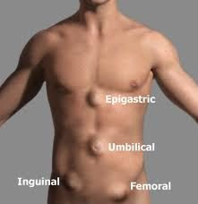
AMK Q6
A 60 year old lady presents with a small, hard painful lump inferior and lateral to the pubic tubercle. She also has abdominal pain, distension, vomiting and absolute constipation. What is the primary pathology?
Inguinal hernia
Femoral hernia
Malignancy
Intussusception
Pregnancy

Slide 45
DONE!
Thanks for listening
Take home messages
Feedback forms (Pleeassssee)

