Slide 1
Peninsula Anatomy Lectures
Session 2 – Oesophageal anatomy & pathology (Part 1)
John Pascoe
F2 Derriford Hospital

Slide 2
What this course adds
Anatomy for exams and for pushy surgical blocks
Clinical situations
Practice AMK questions
We need your feedback

Slide 3
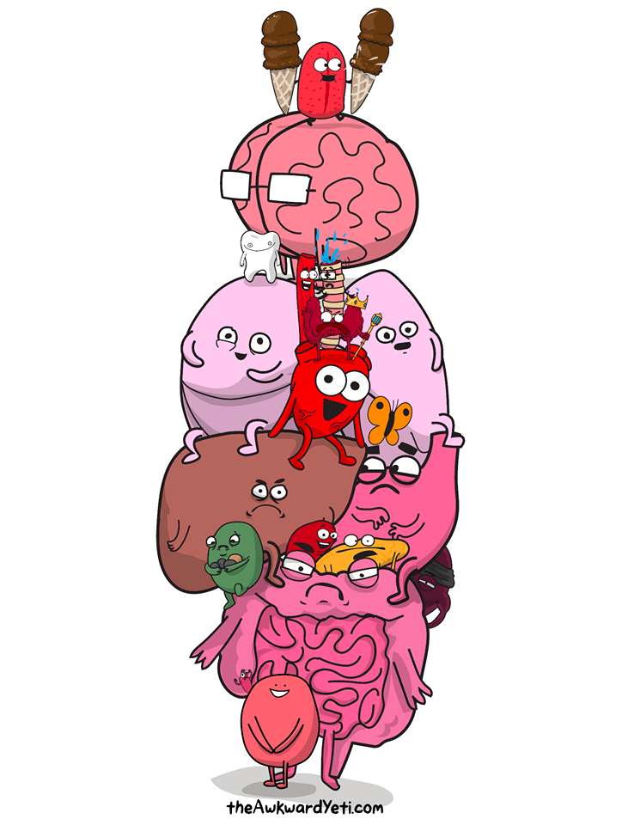
Dull facts
Learning anatomy is not easy
Repetition is key
Mnemonics help
Use in clinical situations

Slide 4
Big Picture
Session 1: Abdominal Wall & Hernias
Session 2: Oesophagus
Session 3: Stomach & duodenum
Session 4: Hepatic/Pancreatic/Biliary
Session 5: Large Bowel, Rectum & Anus
Session 6: The neck
Session 7: The upper limb
Session 9: The lower limb
Session 10: The Brain & Spinal Cord*
Session 11: Cardio-respiratory

Slide 5
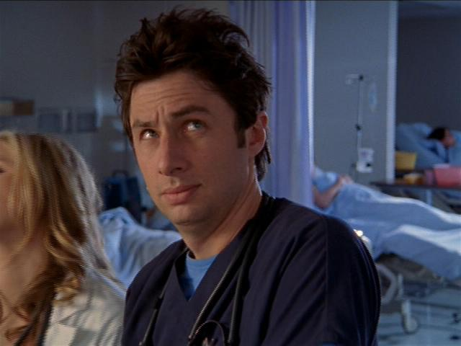
Todays Learning Objectives
Anatomy & function of the oesophagus relating to pathology
+ lots of pictures & AMK questions

Slide 6
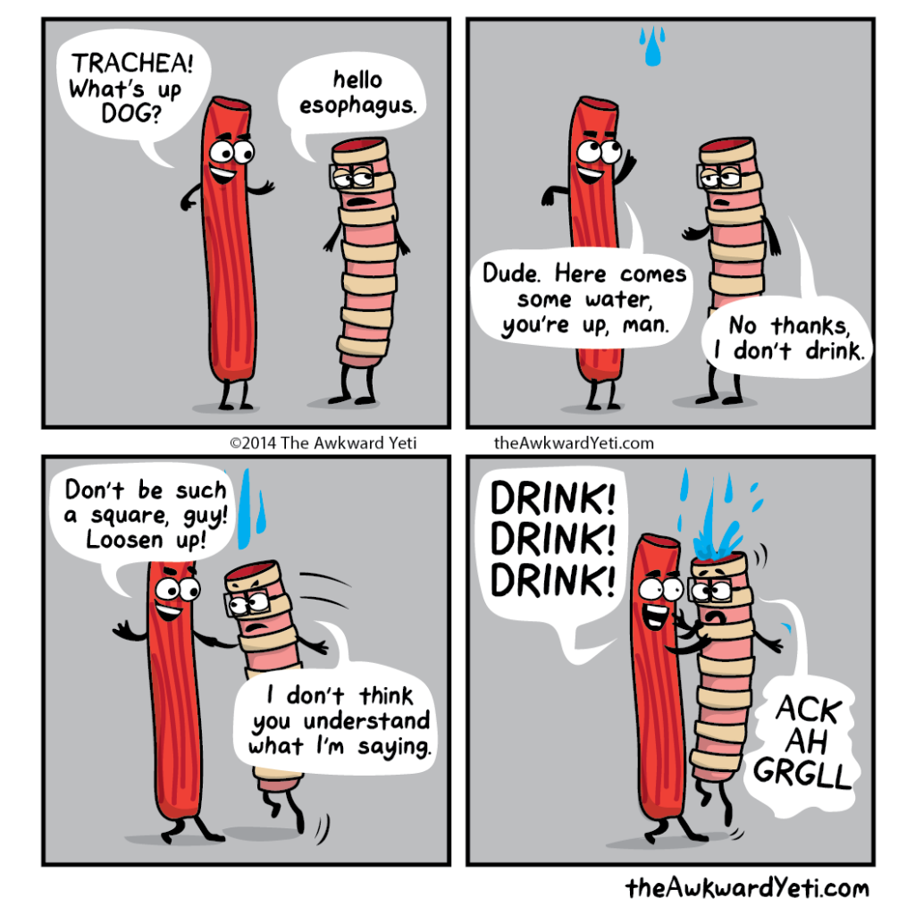
Oesophagus
25 cm long
Divided into thirds
Upper (cervical)
Middle (thoracic)
Lower (thoracic & abdomen)
Surgical approaches differ for different pathologies

Slide 7
Oesophagus – Arterial supply
Upper
Inferior thyroid artery
Middle
Oesophageal branches from aorta & bronchial arteries
Lower
Branches from left gastric & left inferior phrenic arteries

Slide 8
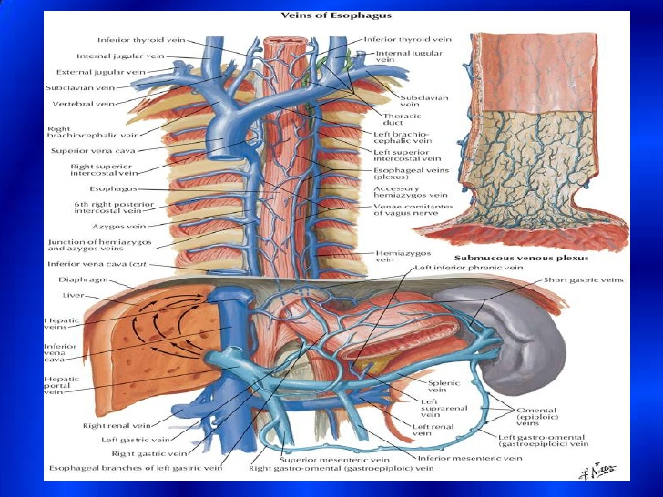
Oesophagus – Venous drainage
Upper
Inferior thyroid, vertebral & brachiocephalic vein
Middle
Azygos & hemi-azygos veins
Lower
L gastric vein draining into the portal system

Slide 9
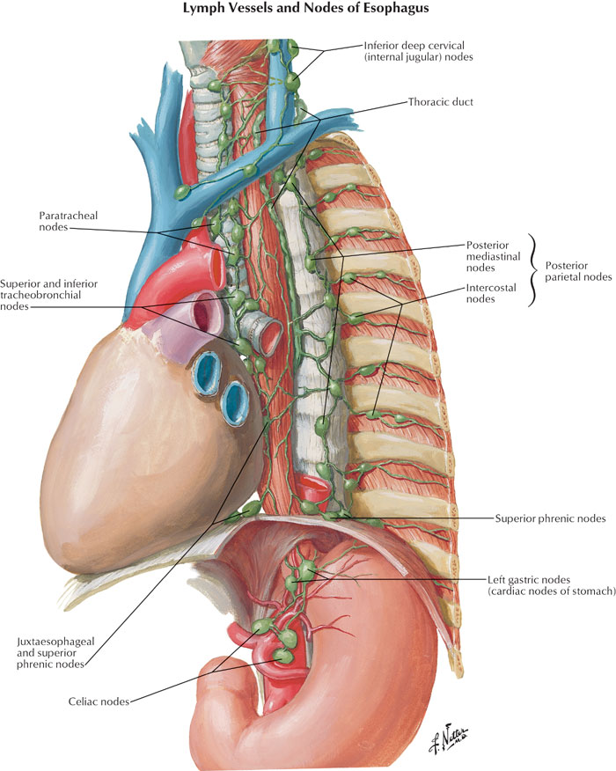
Oesophagus – Lymphatic supply
Upper
Deep cervical
Middle
Posterior mediastinal & tracheobronchial nodes
Lower
L gastric & celiac nodes

Slide 10
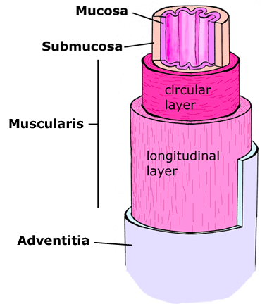
Oesophageal musculature
Mucosa - three subgoup layers: inner epithelial layer, a loose connective tissue layer (lamina propria), and a thin smooth muscle layer (muscularis mucosa).
Submucosa- connective tissue layer
The muscularis is made of an inner circular muscle zone and an outer longitudinal muscle zone.
The adventia, contains the supporting nerves and vessels

Slide 11
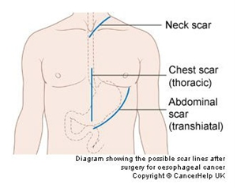
Surgical approach

Slide 12
Swallowing physiology
Three phases - Initially voluntary then reflex
Oral
Bolus of food passes back. Hits pharynx and activates reflexes.
Pharyngeal (<1 second)
Soft palate pulled up. Vocal cords pushed together. UOS relax. Superior constrictor muscle contracts. Peristaltic wave initiated.
Oesophageal
UOS constricts. Autonomic peristalsis. Passes through LOS.
https://www.youtube.com/watch?v=YQm5RCz9Pxc

Slide 13
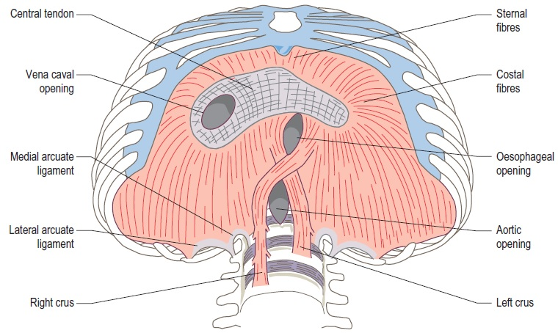
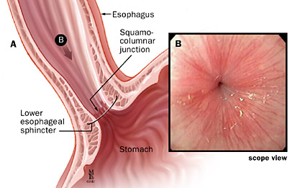
Lower Oesophageal Sphincter
A multitude of anatomical & physiological factors that allow food to pass from Oesophagus to stomach:
A zone of circular smooth muscle at the distal oesophagus
The right diaphragmatic crus
The angle of his
Intraluminal mucosal flap

Slide 14
Recap….That was a lot

