Slide 1
Peninsula Anatomy Lectures
Session 2 – Oesophageal anatomy & pathology (Part 2)
John Pascoe
F2 Derriford Hospital

Slide 2
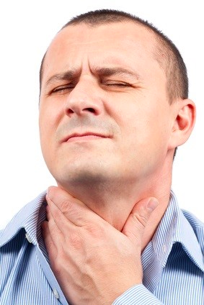
Oesophageal pathology
Dysphagia
Odynophagia
Symptoms often overlap
Many ways to classify & differentiate

Slide 3
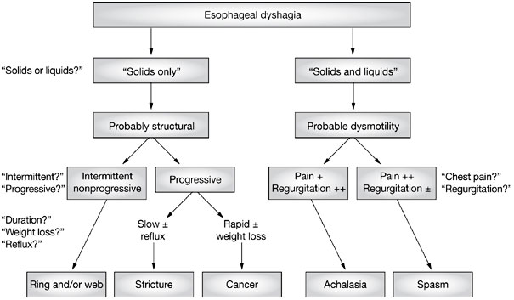
Approaching oesophageal problems
Do NOT forget the neurological causes
Not definitive – Think of:
Infections (thrush/herpes/pharyngitis)
Reflux oesophagitis

Slide 4
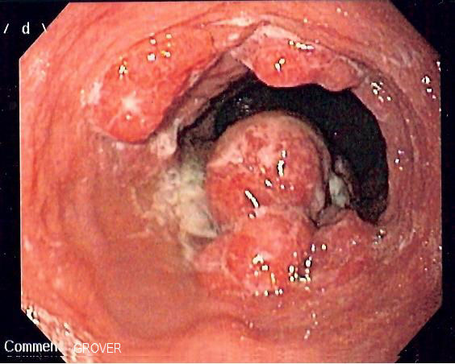
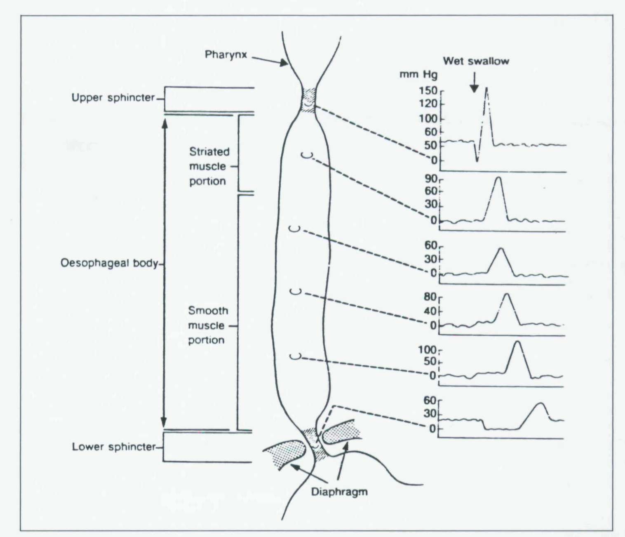
Investigating oesophageal disease
OGD
Barium swallow
Manometery
pH studies
CT

Slide 5
Case 1
Sarah is a 45 year old female who for a year has been suffering from worsening indigestion. She has little PMH other obesity & smoking.
Carry on the history?
What tests do you want as the acute GP in hospital?
What is the most likely diagnosis?
Angina
Oesophageal Cancer
Musculoskeletal CP
Biliary colic

Slide 6
GORD
“The presence of gastric contents in the oesophagus for a prolonged period of time”
Often associated with a hiatus hernia
Three factors keep gastric contents from the Oesophagus
Oesophageal clearance
LOS competence
Gastric clearance
May lead to:
Strictures
Barrett’s Oesophagus**
Mild bleeding

Slide 7
Diagnosing GORD
Worrying features or >55
Yes
OGD with biopsies +/- CT
No
+ve
H.Pylori test
Eradication therapy
-ve
1/12 PPI
Further Ix
No improvement
OGD with biopsies +/- CT

Slide 8
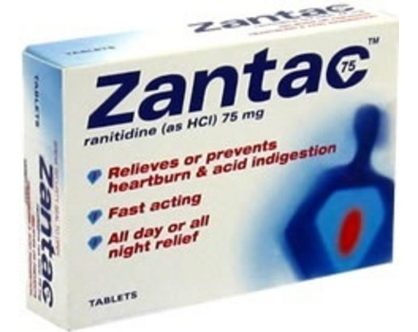
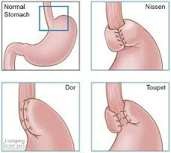
Managing GORD
Conservative
Weight loss/stop smoking/stop drinking/avoid large meals
Medical
Antacids/PPI’s/Metoclopramide/H2-antagonists
Surgical
Most procedures aim to increase lower oesophageal competence by wrapping the stomach
Most common procedure is a Nissen’s fundoplication

Slide 9
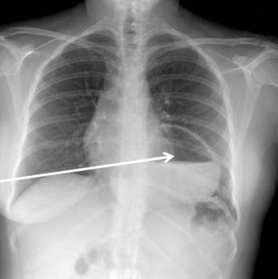
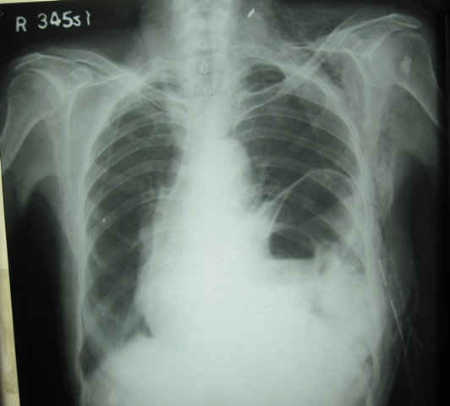
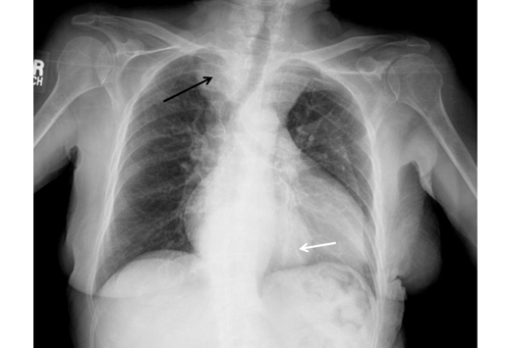
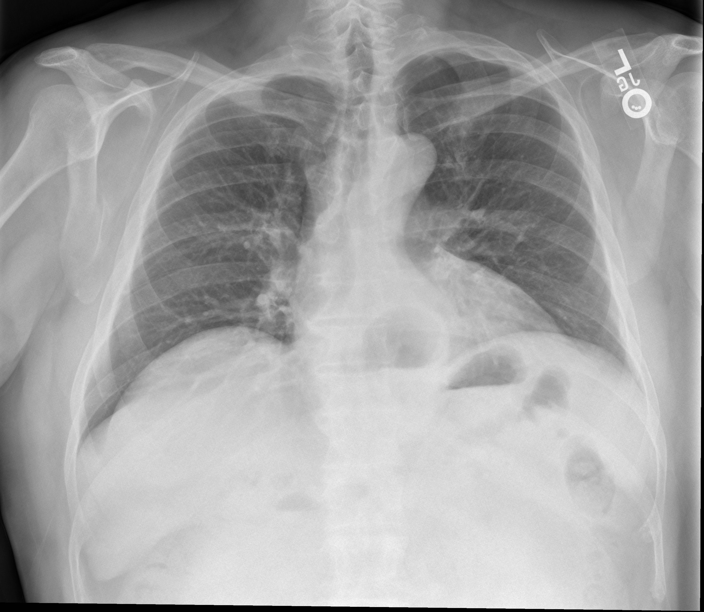
Hiatus hernia
“The protrusion of an organ, usually the stomach, through the oesophageal hiatus in the diaphragm”
Often asymptomatic.
May be associated with GORD

Slide 10
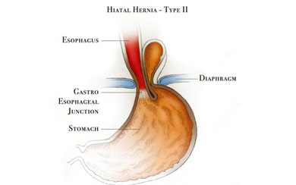
Hiatus Hernias
Type 1
Sliding
Type 2
Paraoesophageal
Type 3
Mixed

Slide 11
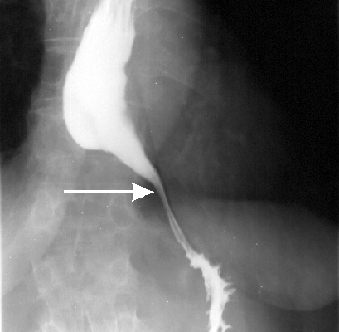
Case 2
Marcus is a 58 year old builder who has developed chest pain and dysphagia to solids and liquids over a week. This is associated with profuse vomitting. It came on at rest. He has no PMH or cardiovascular risk factors.
The hospital have performed blood tests with troponins, an ECG, CXR & even angiography have not yet found any abnormalities.
What is the most likely diagnosis?
Oesophageal spasm
Achalasia
Chaga’s disease
Stroke

Slide 12
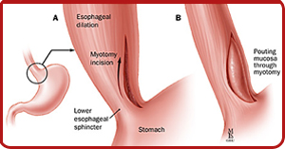
Achalasia
“A condition of by high LOS pressure & failure of LOS relaxation as well as poor peristalsis throughout the oesophagus”
Aetiology unknown – degeneration of the myenteric plexus
Ix: OGD/barium swallow/manometry*
Mx: Ballon dilatation/ Heller’s myotomy/botox

Slide 13
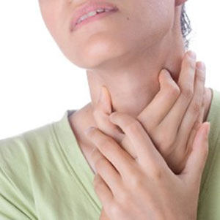
Other motility disorders
Primary
Achalasia
Diffuse oesophageal spasm
Secondary
Autoimmune
Chaga’s
DM
Amyloid
Myasthenia Gravis

Slide 14
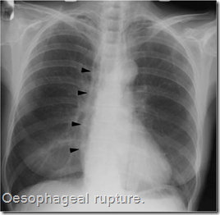
Oesophageal perforation
Three main types
Spontaneous
Penetrating injury
Iatorogenic
Treatment aims
Resus
NBM
Abx
PN
PPI’s/analgesia
Conservative before Surgical intervention unless massive rupture

Slide 15
Case 4
Roy is a 70 year old male with a 6/12 history of fatigue, weight loss, palpable cervical lymph nodes & he has come to see his GP as he has been struggling to swallow solids.
What is Roy’s most likely diagnosis?
Non-Hodgkins Lymphoma
Oesophageal cancer
GORD
Peptic ulcer disease

Slide 16
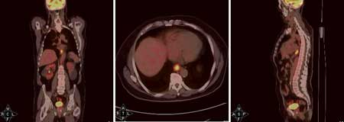
Oesophageal cancer
M:F 3:1. Rare<40
Geographic preponderance
Main subtypes
Adenocarcinoma
SCC
Rarer subtypes
Diagnosis
OGD
EUSS
CT TAP/PET

Slide 17
Management of Oesophageal Ca.
5 year survival 25%
Stage using the TNM system – No mets and fit – evaluate for surgery
Neoadjuvant chemotherapy/radiotherapy may be used
Only a small proportion of patients are suitable for resection – palliative measures may often be more appropriate

Slide 18
Surgical approach
Ivor – Lewis procedure
Mckeown three phase oesophagectomy
Trans-hiatal resection

Slide 19
DONE!
Thanks for listening
Take home messages
Feedback forms (PLEASSSSSSEEE)

