Slide 1
Peninsula Anatomy Lectures
Session 3 – Stomach & duodenum anatomy & pathology (Part 1)
John Pascoe
F2 Derriford Hospital

Slide 2
What this course adds
Anatomy for exams and for pushy surgical blocks
Clinical situations
Practice AMK questions
We need your feedback

Slide 3
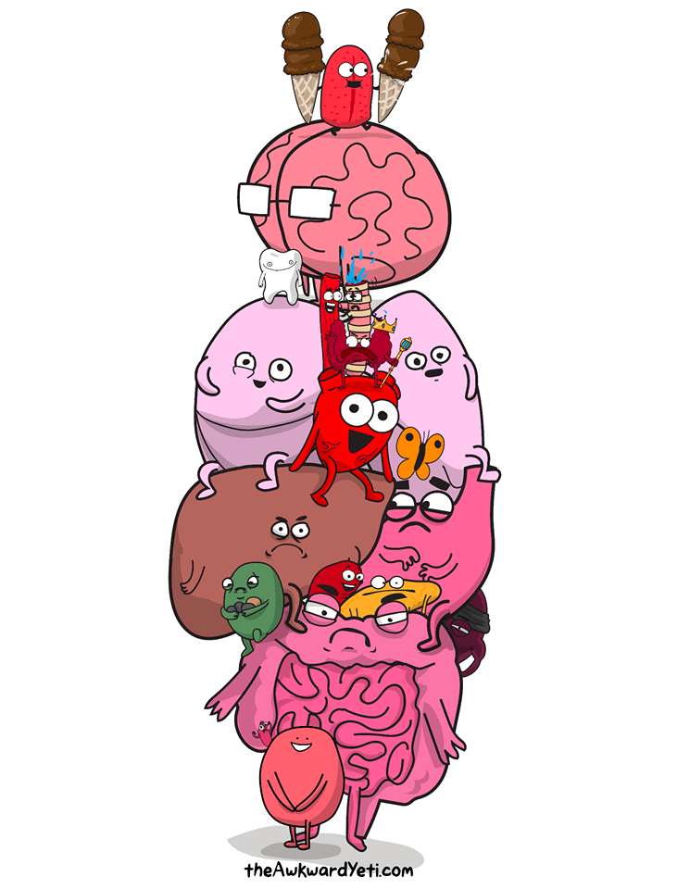
Dull facts
Learning anatomy is not easy
Repetition is key
Mnemonics help
Use in clinical situations

Slide 4
Big Picture
Session 1: Abdominal Wall & Hernias
Session 2: Oesophagus
Session 3: Stomach & duodenum
Session 4: Liver & Spleen
Section 5: Pancreatic/Biliary
Session 6: Large Bowel, Rectum & Anus
Session 7: The neck
Session 8: The upper limb
Session 9: The lower limb
Session 10: The Brain
Section 11: The Spinal cord
Session 12: Cardio-respiratory

Slide 5
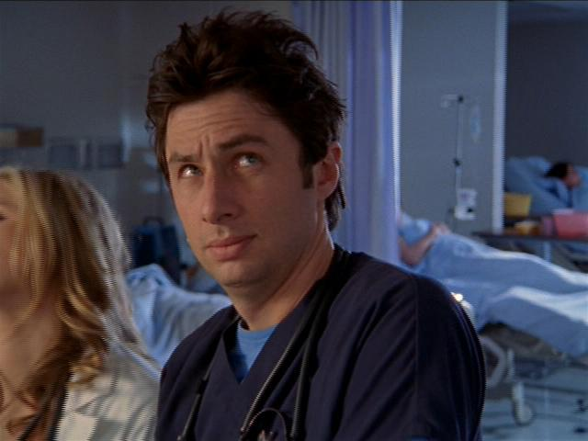
Todays Learning Objectives
Anatomy & function of the stomach & duodenum relating to pathology
+ lots of pictures & AMK questions

Slide 6
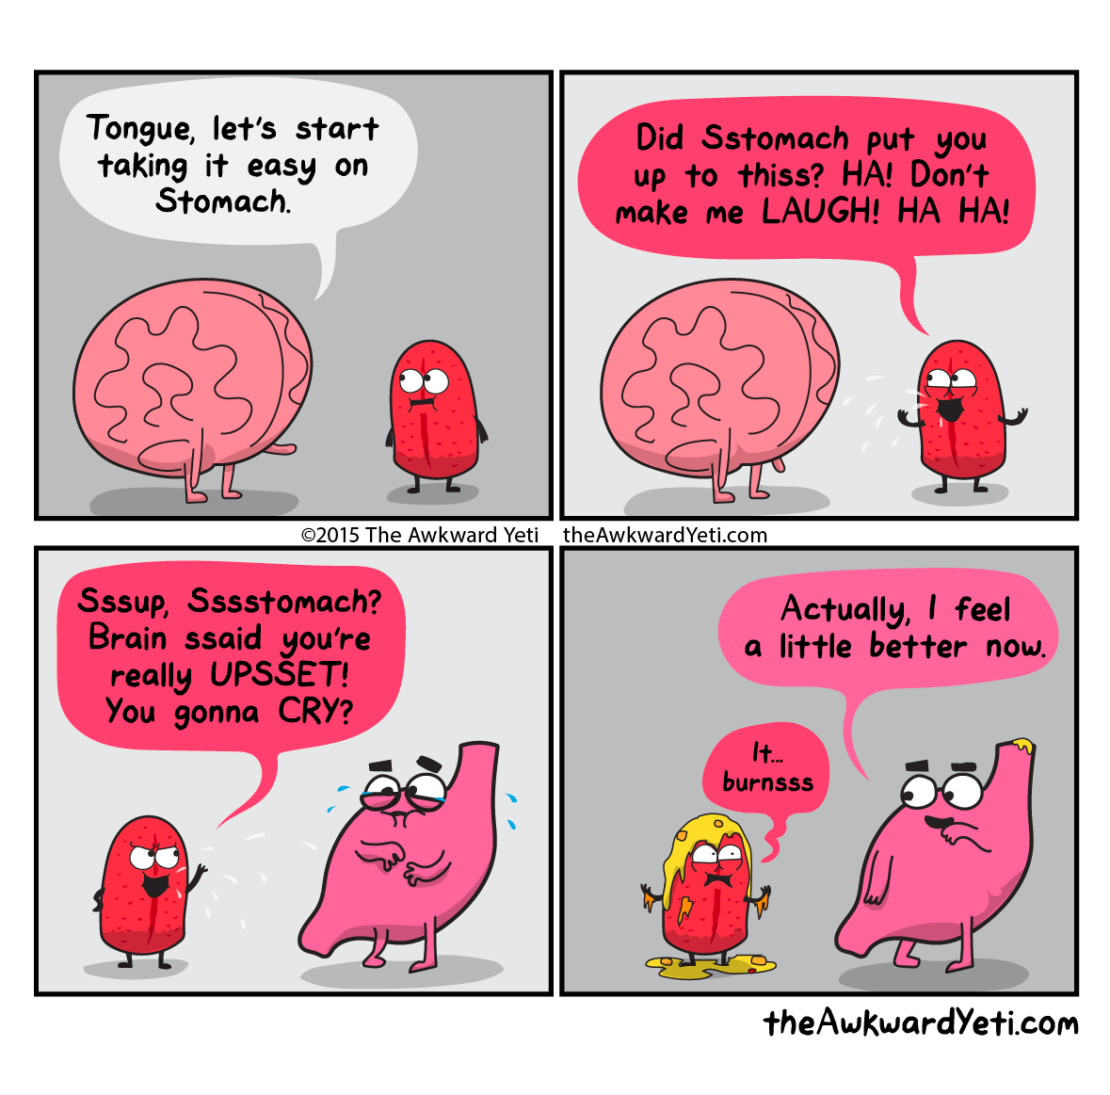
The stomach
J shaped organ
Lies between T7 & L3
Pyloric sphincter connects to the duodenum
Multi function:
Mixer
Secretor
Digester
Gatekeeper

Slide 7
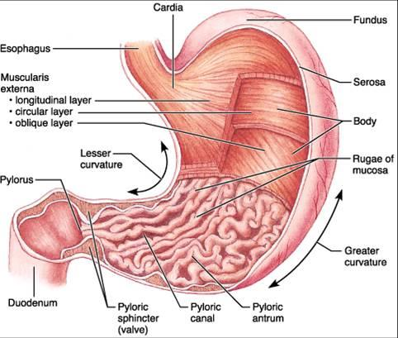
The stomach
Cardia
Fundus
Body
Pylorus
Curvatures: Greater & Lesser
Muscular layers

Slide 8
Back to basics: Peritoneum
What is the peritoneum?
“A double layered membrane, supporting the viscera and holding them to the abdominal walls”
What are the greater & lesser omenta?
Greater (immune role)
“Four layers of peritoneum. It descends from the greater curvature of the stomach and proximal part of the duodenum, then folds back up and attaches to the anterior surface of the transverse colon”
Lesser (attachment)
“Attaches from the lesser curvature of the stomach and the proximal part of the duodenum to the liver”

Slide 9
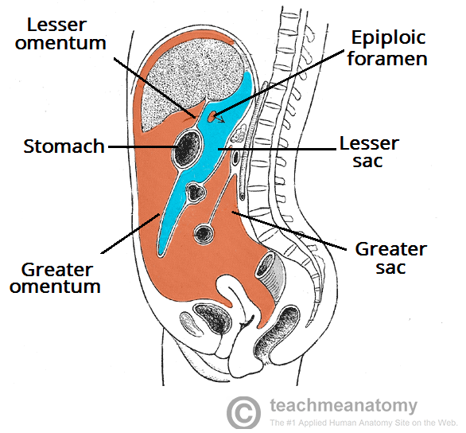
Peritoneal Cavity
The omenta divide the peritoneal cavity into the greater & lesser sac
The epiploic foramen

Slide 10
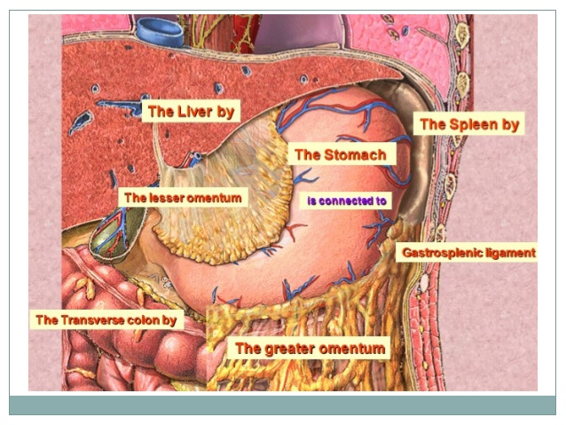
Relations of the stomach
The lesser omentum
The gastrolcolic ligament
The gastrosplenic omentum
Stomach bed

Slide 11
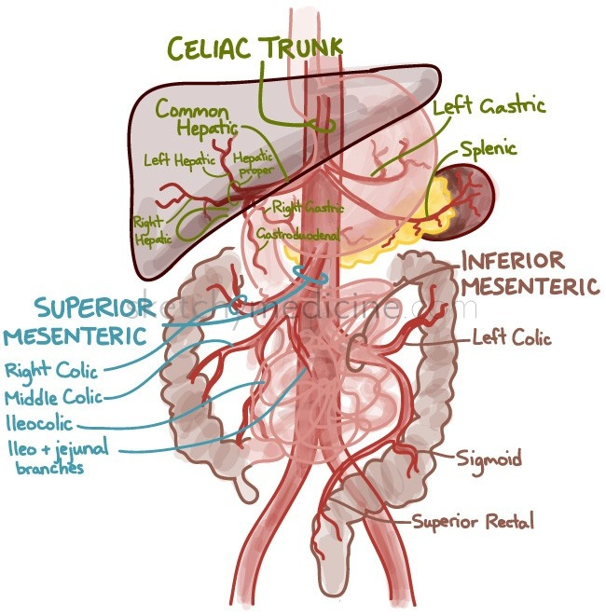
Arterial Supply to the GI tract
Coeliac trunk
Foregut
Anterior T12
Stomach – where bile duct enters duodenum
Superior mesenteric artery
Midgut
Inferior L1
Where bile ducts enter duodenum to distal 2/3 of transverse colon
Inferior mesenteric artery
Hindgut
L3
Distal 2/3 of transverse colon to rectum

Slide 12
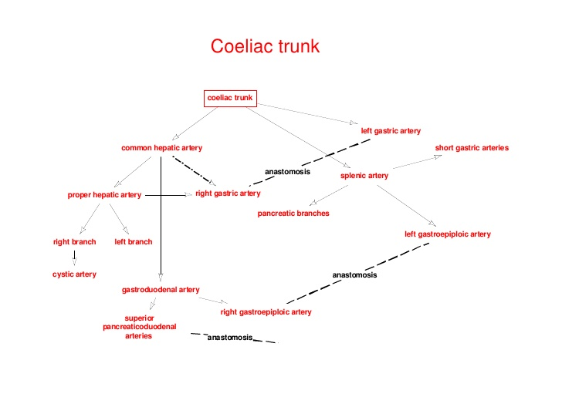
Coeliac trunk

Slide 13
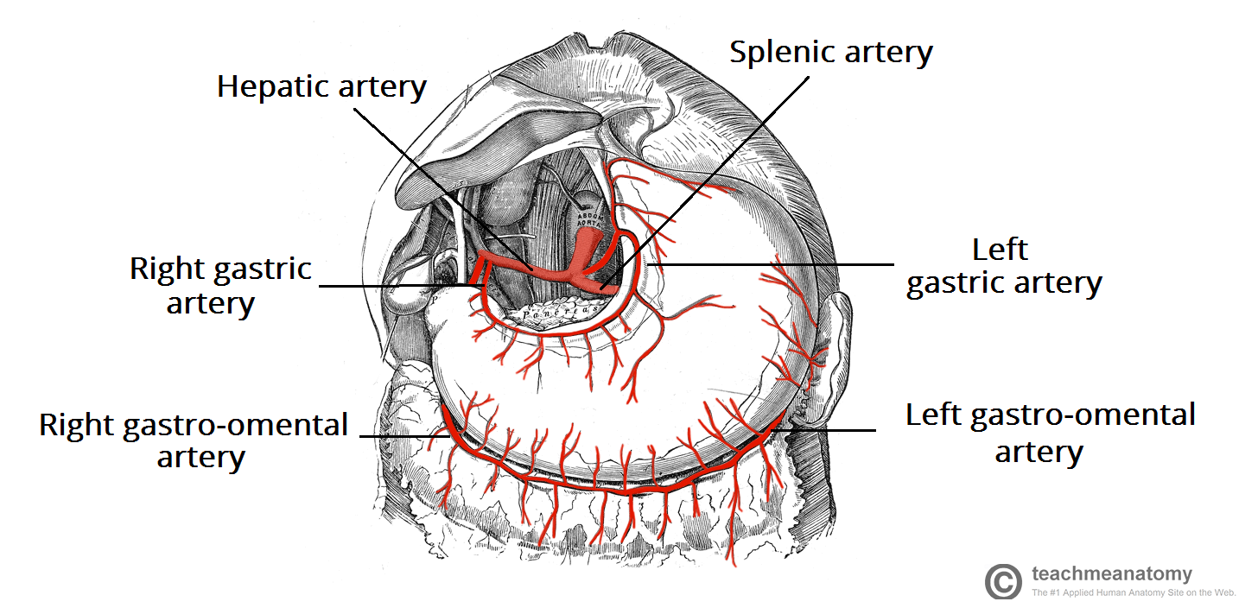
Arterial supply to the stomach
Lesser Curvature
R & L gastric arteries
Fundus & L upper side
Short gastric from splenic artery in gastrosplenic ligament
Lower curvature
L & R Gastro-omental arteries

Slide 14
Venous drainage from the stomach
Follows arterial pattern
Exceptions
No gastroduodenal vein
Prepyloric vein of mayo
Drain into portal venous system

Slide 15
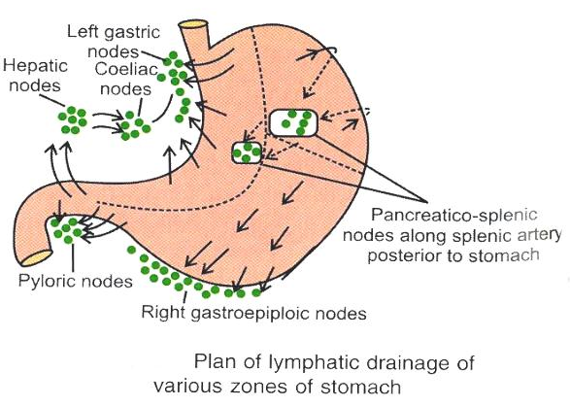
Lymphatic drainage of the stomach
I Gastric Nodes
II Pancreatico-splenic nodes
III Gastricepiploic & pyloric nodes

Slide 16
Nervous supply to the stomach
Parasympathetic supply
From the posterior vagal trunks, derived from the vagus nerve.
Parasympathetic activity increases stomach motility, gastric juice secretion and relaxation of the sphincters.
Sympathetic supply
From the T6-T9 spinal cord segments pass to the celiac plexus.
Sympathetic activity reduces motility, contracts the sphincters and inhibits gastric juice secretion.

Slide 17
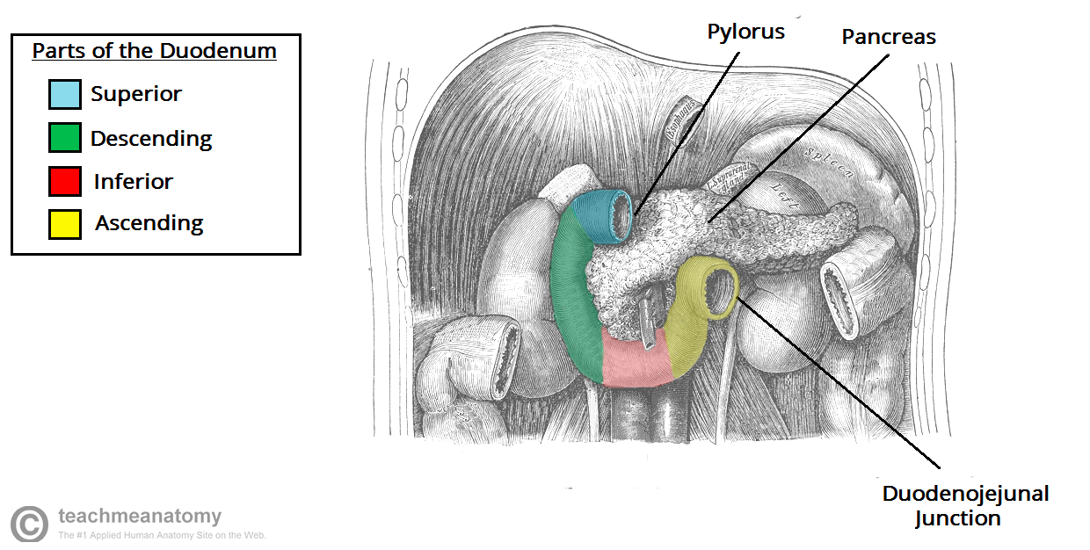
Duodenum
First portion of small bowel
Four parts
1st Duodenal cap
2nd Bile duct and pancreatic ducts enter
3rd Longest portion
4th enters jejunum
Lymph Drains into celiac & superior mesenteric nodes

Slide 18
Functions of the stomach (Many Stomachs Digest Greens)
Mixer
Secretor
Digester
Gatekeeper

Slide 19
Functions of the stomach (Many Stomachs Digest Greens)
Mixer
Cells of Cajal on the greater curvature generate peristaltic waves
Mixed food + digestive enzymes = chyme
Allows small volumes of chyme out of pyloric sphinter in small volumes
Secretor
Digester
Gatekeeper

Slide 20
Functions of the stomach (Many Stomachs Digest Greens)
Mixer
Secretor (2/3L per day)
H₂O, Electrolytes, mucus, acid, histamine, intrinsic factor, gastrin & other enzymes.
M cells – Mucus
Parietal cells – HCl
G celles - gastrin
Chief cells - pepsinogen
Digester
Gatekeeper

Slide 21
Functions of the stomach (Many Stomachs Digest Greens)
Mixer
Secretor
Digester
Digests 20% of proteins in meals
Aids Fe, Ca²⁺ & Vit B12 absorbtion
Conversion to chyme aids digestion in the distal portion of the GI tract
Gatekeeper

Slide 22
Functions of the stomach (Many Stomachs Digest Greens)
Mixer
Secretor
Digester
Gatekeeper
Controlled volume passage
Ensures empty duodenum
Prevents overload of digestion products to circulation

