Slide 1
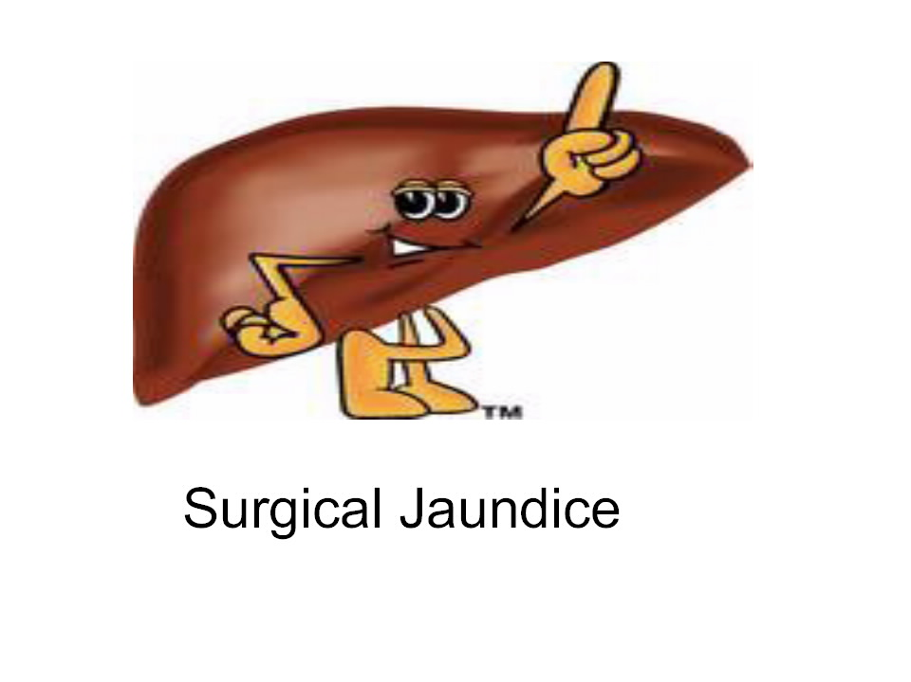

Slide 2
Surgical jaundice
Anatomy
Pathophysiology
The spectrum of gallstone disease
Painless jaundice

Slide 3
BASIC ANATOMY

Slide 4
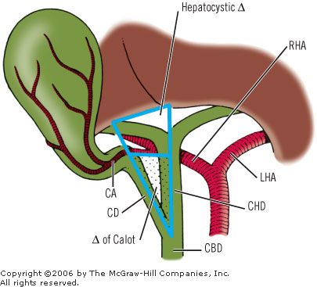
Anatomy questions the surgeons like
1) How wide is a healthy common bile duct?
2) What is Hartmann’s Pouch?
3) What are the borders of Calot’s triangle & what is in it?

Slide 5
Bilirubin metabolism – 2 quick videos
https://www.youtube.com/watch?v=4K9i7MPeuVg
https://www.youtube.com/watch?v=-bZmC07L394

Slide 6
Pathophysiology of jaundice
Pre-hepatic
Unconjugated Hyperbilirubinaemia
Haemolytic( i.e. mostly medical)

Slide 7
Pathophysiology of jaundice
Intra-hepatic
Unconjugated Hyperbilirubinaemia
Damaged hepatocytes ( i.e. still mostly medical)

Slide 8
Pathophysiology of jaundice
Post-hepatic/Obstructive
Conjugated Hyperbilirubinaemia
Intrahepatic – fibrosis/swelling causing obstruction (medical)
Extrahepatic – Surgical

Slide 9
The spectrum of gallbladder disease
Wide spectrum of presentations
Enough goes wrong to employ at TBH in UGI:
3 consultants
2 SpR’s
Dedicated F2
2 Specialist Nurses

Slide 10
Scenario 1
47 female
RUQ pain -comes in waves
Now settled
Systemically well
Bloods
WCC & CRP NAD
LFT’s NAD
1) What is the diagnosis
2) What should you do?
3) What might an USS show

Slide 11
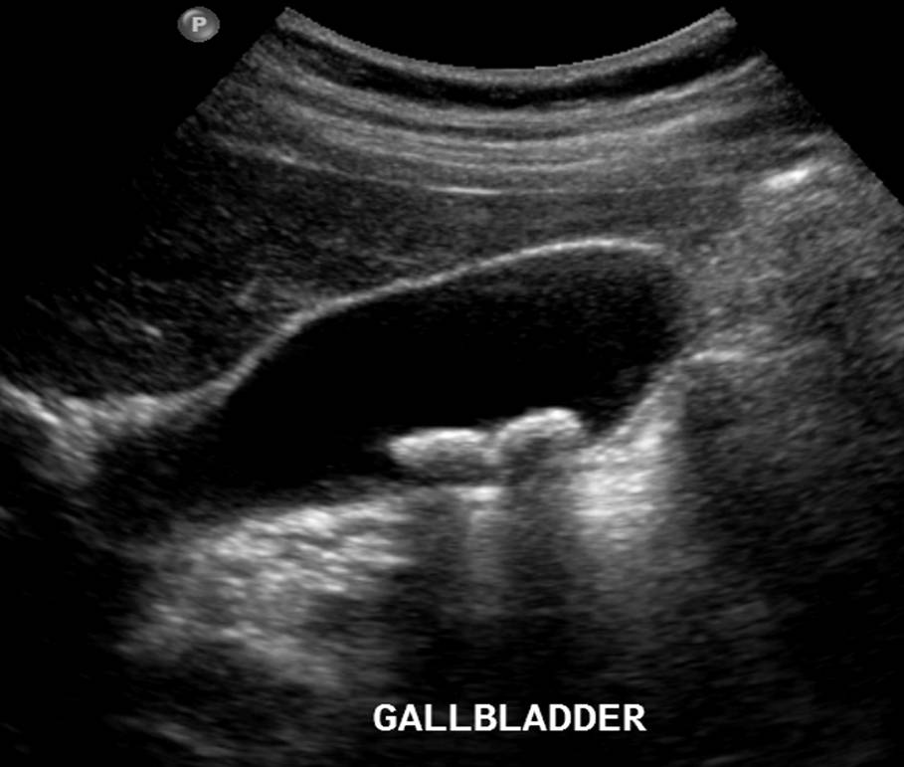
Biliary Colic

Slide 12
Scenario 2
47 female
RUQ pain -comes in waves
OE tender RUQ & Murphy’s +ve
Bloods
WCC 19.5
Neut 10
CRP 105
LFT’s NAD
1) What is the diagnosis
2) What should you do?
3) What might a USS show

Slide 13
Cholecystitis

Slide 14
Scenario 3
47 female
RUQ pain -comes in waves
OE tender RUQ & Murphy’s +ve
Jaundiced
Afebrile
Bloods
WCC 19.5
Neut 10
CRP 105
LFT’s obstructive picture
1) What is the diagnosis
2) What should you do?
3) What may the USS show?
4) What if they were febrile/behaving septic?

Slide 15
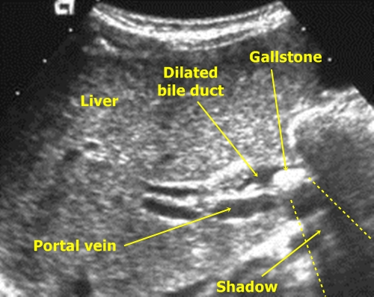
Choledocolethiasis

Slide 16
Scenario 4
47 female
Severe epigastric pain. Worse lying flat
Old USS shows gallstones
Jaundiced
Afebrile
Bloods
WCC 19.5
Neut 10
CRP 105
LFT’s obstructive picture
Amylase 3000
1) What is the diagnosis
2) What should you do?
3) What may the USS show?

Slide 17
Scenario 5
47 female
4/52 post lap cholecystectomy
Pain & Jaundice
Bloods
WCC 19.5
Neut 10
CRP 105
LFT’s obstructive picture
1) What is the diagnosis
2) What should you do?
3) What imaging could be done?

Slide 18
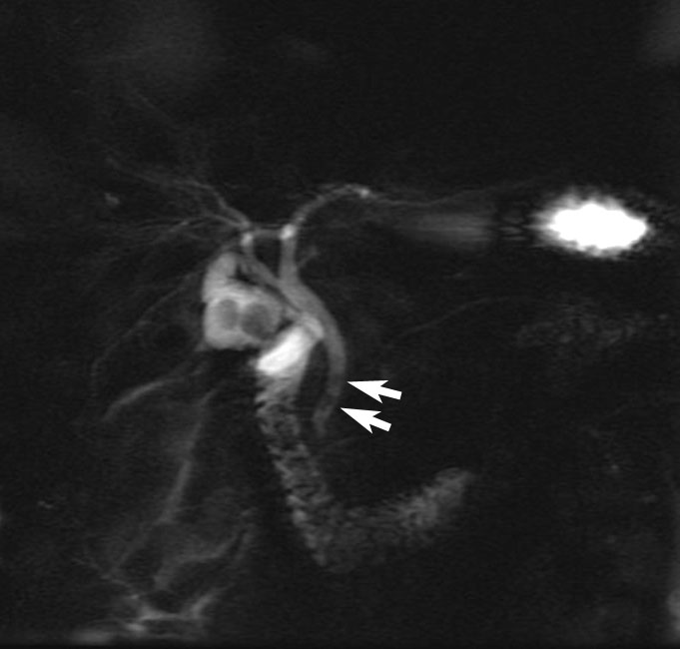
MRCP

Slide 19
Looking clever – Mirrizi Syndrome
Does anyone know what it is?
“Stone trapped in hartmann’s pouch causing compression of the CBD & a spectrum of disease”
Can lead to gallstone ileus
Staging
(I) CBD compression. No Lumen narrowing
(II) CBD compression. Lumen narrowing
(III) CBD compression. Wall necrosis
(IV) Choledocofistula formation

Slide 20
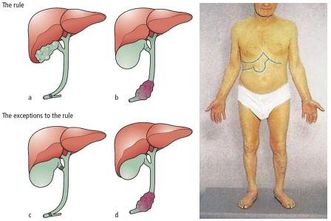
Painless jaundice
Courvosier’s Law
Until proven otherwise….Pancreatic carcinoma

Slide 21
